Slide 1
Numerical Integration – Trapezoidal & Simpson’s method
Group 15
Berces, Arthur William
Damasco, Vinard James
Espiritu, Kyle Gabrielle

Slide 2
Numerical Integration - Definition
Numerical integration comprises a broad family of algorithms for calculating the numerical value of a definite integral, and by extension, the term is also sometimes used to describe the numerical solution of differential equations.

Slide 3
Numerical Integration - History
The term "numerical integration" first appears in 1915 in the publication A Course in Interpolation and Numeric Integration for the Mathematical Laboratory by David Gibb.
The numerical computation of an integral is sometimes called quadrature.
Quadrature is a historical mathematical term that means calculating area. Quadrature problems have served as one of the main sources of mathematical analysis. Mathematicians of Ancient Greece, according to the Pythagorean doctrine, understood calculation of area as the process of constructing geometrically a square having the same area (squaring). That is why the process was named quadrature.

Slide 4
Numerical Integration - Purpose
We can use numerical integration to estimate the values of definite integrals when a closed form of the integral is difficult to find or when an approximate value only of the definite integral is needed.

Slide 5
Trapezoidal Method - Definition
In mathematics, the trapezoidal rule, also known as the trapezoid rule or trapezium rule is a technique for approximating the definite integral in numerical analysis. The trapezoidal rule is an integration rule used to calculate the area under a curve by dividing the curve into small trapezoids.

Slide 6
Trapezoidal Method – Purpose
In numerical analysis, this rule is a technique for approximating the definite integral. In this rule, the approximation is done on the region under the graph of f(x) as a trapezoid and then the area of that trapezoid is calculated. The result of the trapezoidal rule tends to be more accurate than the other methods.

Slide 7
Simpson’s Method – Definition
A method for approximating the area under a curve over a given interval that involves partitioning the interval by an odd number n + 1 of equally spaced ordinates and adding the areas of the n/2 figures formed by pairs of successive odd-numbered ordinates and the parabolas which they determine with their included even-numbered ordinates

Slide 8
Simpson’s Method – Purpose
Simpson's Rule is a numerical method for approximating the integral of a function between two limits, a and b. It's based on knowing the area under a parabola, or a plane curve. In this rule, N is an even number and h = (b - a) / N.

Slide 9
What is the program all about?
The program is a calculator that uses Trapezoidal and Simpson’s rule of integration. The Trapezoidal Rule is the average of the left and right sums, and usually gives a better approximation than either does individually. Simpson's Rule uses intervals topped with parabolas to the approximate area; therefore, it gives the exact are beneath quadratic functions. It will give the user a calculated result with absolute error.

Slide 10

How to execute the program?
Download the archived .rar file we have uploaded in Blackboard and save it in your Downloads directory

Slide 11

How to execute the program?
Once downloaded, extract its contents in the same directory

Slide 12
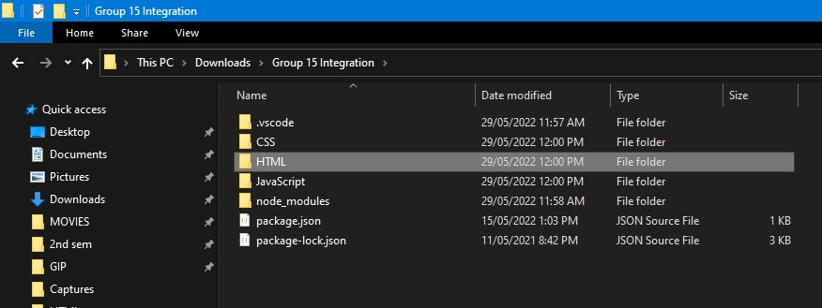
How to execute the program?
Once extracted, open the folder named “HTLM”

Slide 13
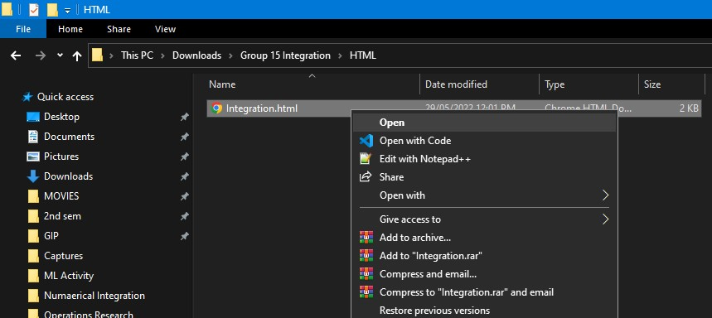
How to execute the program?
Once inside the folder named “HTML”, double-click or right-click and open the file named “Integration”

Slide 14
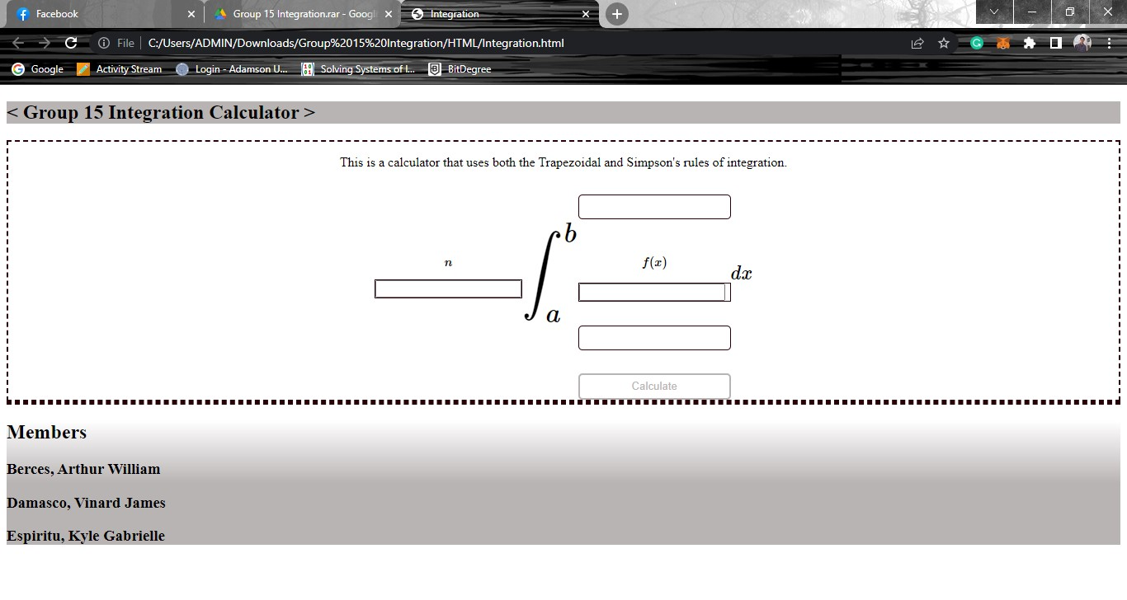
How to execute the program?
You can now use our program

Slide 15
Thank You

